Slide 1
Category review: Chips
June 2020
Retail Analytics
Brand note: If client logo is not required, use alternate title page layout right click slide thumbnail > Layout > Title

Slide 2
Notes:
To view Privacy video explaining how important data privacy is to Quantium, please click here: https://www.youtube.com/watch?v=Zq1QDAkoRzU
or here Q:\Company Reference\Brand & Design\Brand videos\Q Privacy.mp4
At Quantium, we believe that data is the behavioural footprint of humanity and that it has to be treated with the utmost care and responsibility.
Histories, attitudes, indeed lives are stored within it in ways that aren’t always apparent – and that’s what makes its potential so powerful.
To work with it responsibly, sensitively, we set ourselves the highest data privacy protection and governance standards.
We have spent 17 years perfecting privacy-by-design and secure-by-design principles. Central to this is not holding any personally identifiable information about people –
we neither receive it, and put the necessary protections in place to be unable to decipher it.
Every aspect of handling data is safeguarded: from its de-identification, to its encryption – data security is paramount and of the highest grade.
We pride ourselves on gaining the trust of iconic organisations around the world through years of securely working with their data,
and in turn the trust that builds with their stakeholders.

Slide 3
Executive summary
01
Task 1
Top 3 Best Selling Brands Are:
Kettle
Smiths
Doritos
Best-selling package sizes :
175g
Top 3 Lifestage :
Retirees 20.38%
Older Singles/couples 20.11%
Young Single/Couples 19.88%
02

Slide 4
01
Category

Slide 5
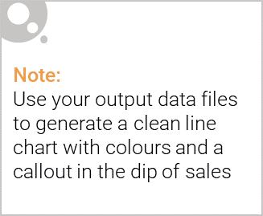
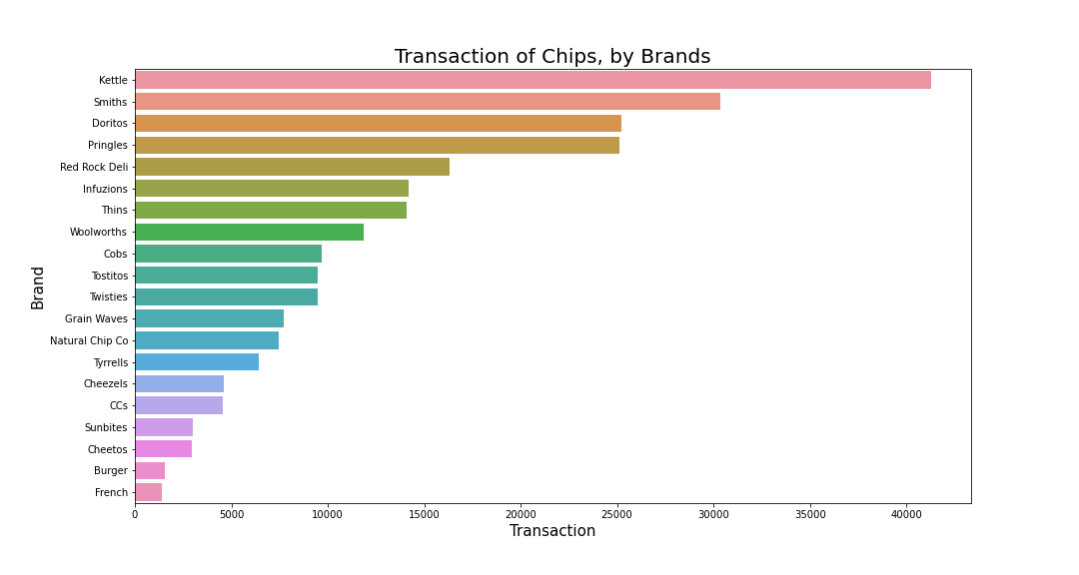
The Plot is showing transaction data for chips and for which brand the max amount of transaction has been done

Slide 6
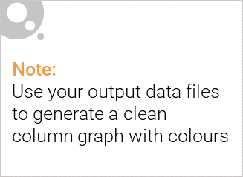
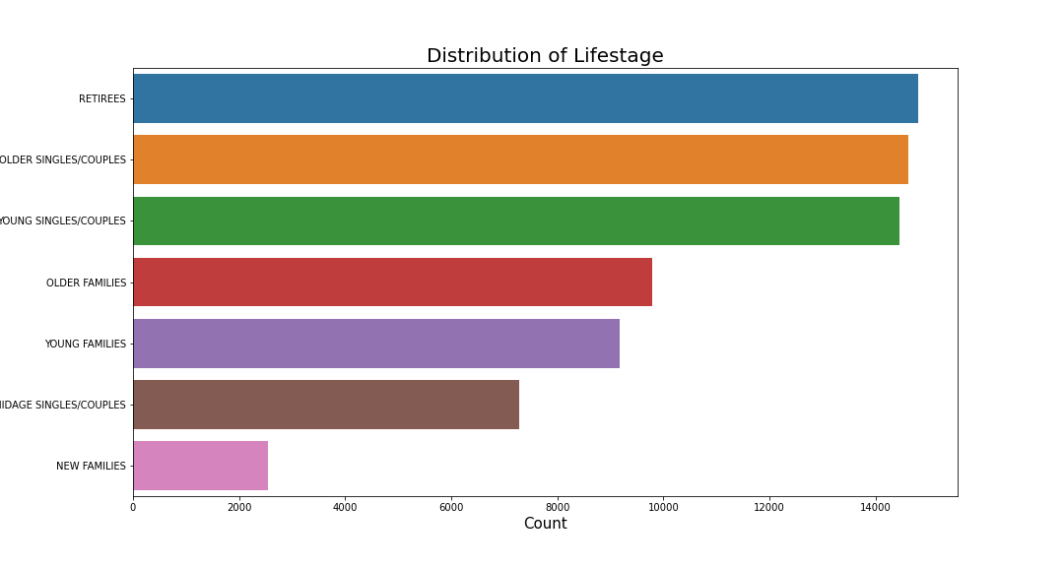
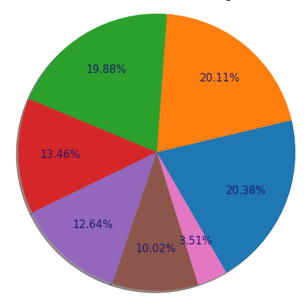
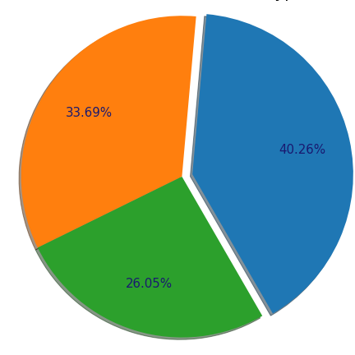
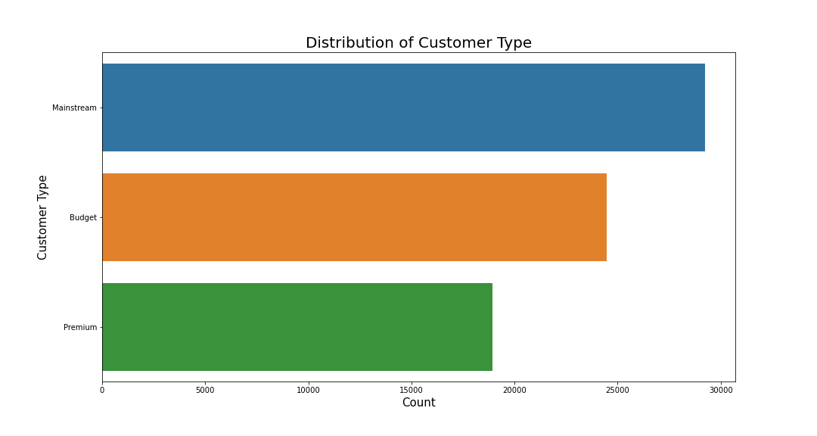
This slide will be commentary on affluence and its effect on consumer buying for the category of chips

Slide 7
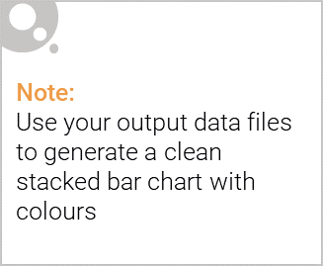
Editable (delete this)
Stretch: Try visualising the proportion of customers by affluence and life stage on this slide

Slide 8
02
Trial store performance

Slide 9
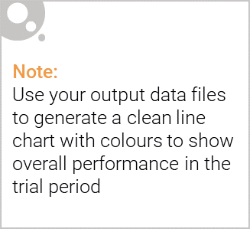
Explanation of the control store vs other stores

Slide 10
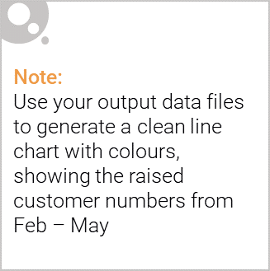
Call out of the performance in the trial store, determining if it was successful

